Slide 1
Dissociative Disorders and Somatic Symptom-Related Disorders
Dissociative Disorders
Somatic Symptom and Related Disorders

Slide 2
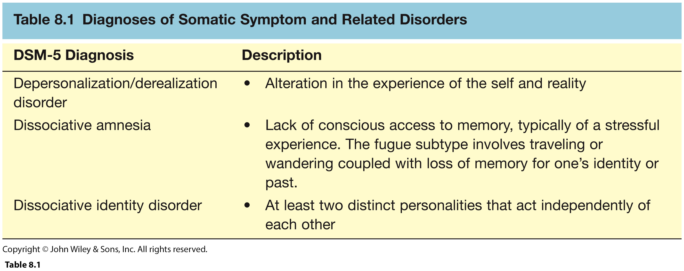
Key Features of Dissociative Disorders

Slide 3
Dissociative Disorders (Introduction)
Dissociation
Some aspect of cognition or experience becomes inaccessible to consciousness
Some types of dissociation are harmless and common (e.g., losing track of time)

Slide 4
Dissociative Disorders Cont’d…
Sudden disruption in the continuity of:
Consciousness
Emotions
Motivation
Memory
Identity

Slide 5
Dissociation and Memory
How does memory work under stress?
Psychodynamic
- Traumatic events are repressed
Cognitive
- Extreme stress usually enhances rather than impairs memory
Interference in memory formation
- Not accessible to awareness later

Slide 6
Memory Deficits and Dissociation
Memory deficits in explicit but not implicit memory
Explicit memory
Involves conscious recall of experiences
- e.g., Last promotion, daughter’s birthday party
Implicit memory
Underlies behaviors based on experiences that cannot be consciously recalled
- e.g., riding a bicycle, writing a check

Slide 7
Memory Deficits and Dissociation
Distinguishing other causes of memory loss from dissociation:
Major Neurocognitive Disorder (MND)
Memory fails slowly over time
Is not linked to stress
Accompanied by other cognitive deficits
Inability to learn new information
Memory loss after a brain injury
Substance abuse >>>

Slide 8
Depersonalization/Derealization Disorder
Perception of self is altered
Triggered by stress or traumatic event
No disturbance in memory
No psychosis or loss of memory
Often co-morbid with anxiety, depression
Typical onset in adolescence
Chronic course
Symptoms are not explained by substances, another dissociative disorder, another psychological disorder, or a medical condition

Slide 9
DSM-5 Criteria: Depersonalization/Derealization Disorder
Experiences of depersonalization or detachment from one’s mental processes as if one is in a dream
Unusual sensory experiences
Limbs feel deformed or enlarged
Voice sounds different or distant
Feelings of detachment or disconnection
Watching self from outside
Floating above one’s body

Slide 10
DSM-5 Criteria: Depersonalization/Derealization Disorder Cont’d…
Or experiences of derealization
World has become unreal
World appears strange, peculiar, foreign, dream-like
Objects appear at times strangely diminished in size, at times flat
Incapable of experiencing emotions
Feeling as if they were dead, lifeless, mere automatons
Experiences of unreality of surroundings

Slide 11
DSM-5 Criteria: Depersonalization/Derealization Disorder Cont’d…
Or experiences of derealization Cont’d…
Symptoms are persistent or recurrent
Reality testing remains intact
Symptoms are not explained by substances, another dissociative disorder
>>>

Slide 12
DSM-5 Criteria: Dissociative Amnesia
Inability to remember important personal information, usually of a traumatic or stressful nature, that is too extensive to be ordinary forgetfulness
The amnesia is not explained by substances, or by other medical or psychological conditions
Need to rule out other possible causes of memory loss

Slide 13
DSM-5 Criteria: Dissociative Amnesia Cont’d…
Specify dissociative fugue subtype if the amnesia is associated with bewildered or apparently purposeful wandering
Usually remits spontaneously

Slide 14
Dissociative Amnesia: Dissociative Fugue Subtype
Amnesia and flight and new identity
Latin fugere, “to flee”
Sudden, unexpected travel with inability to recall one’s past
Assume new identity
May involve new name, job, personality characteristics
More often of brief duration
Remits spontaneously

Slide 15
DSM-5 Criteria for Dissociative Amnesia Cont’d…
Specify dissociative fugue subtype if:
the amnesia includes inability to recall one’s past, confusion about identity, or assumption of a new identity, and
sudden, unexpected travel away from home or work
>>>

Slide 16
Dissociative Identity Disorder (DID)
Two or more distinct and fully developed personalities (alters)
Each has unique modes of being, thinking, feeling, acting, memories, and relationships
Primary alter may be unaware of existence of other alters
Most severe of dissociative disorders
Recovery may be less complete

Slide 17
Dissociative Identity Disorder (DID) Cont’d…
Typical onset in childhood
Rarely diagnosed until adulthood
More common in women than men
Often comorbid with:
PTSD, major depression, somatic symptoms
Has no relation to schizophrenia
No thought disorders or behavioral disorganization

Slide 18
DSM-5 Criteria for Dissociative Identity Disorder (DID)
Disruption of identity characterized by two or more distinct personality states (alters) or an experience of possession, as evidenced by discontinuities in sense of self as reflected in altered cognition, behavior, affect, perceptions, consciousness, memories, or sensory-motor functioning.
This disruption may be observed by others or reported by the patient

Slide 19
DSM-5 Criteria for Dissociative Identity Disorder (DID) Cont’d…
Recurrent gaps in recalling events or important personal information that are beyond ordinary forgetting
Symptoms are not due to drugs or a medical condition

Slide 20
Etiology of Dissociative Identity Disorder (DID): Two Major Theories
Trauma Theory (Posttraumatic Model)
DID, formerly, multiple personality disorder, usually occurs in people who experienced overwhelming stress or trauma during childhood
Children are not born with a sense of a unified identity; it develops from many sources and experiences

Slide 21
Etiology …
Sociocognitive model of dissociative identity disorder (DID; formerly, multiple personality disorder), According to sociocognitive model: DID is not a valid psychiatric disorder of posttraumatic origin; rather, it is a creation of psychotherapy and the media.
Because it is so rare, no prospective studies have been conducted

Slide 22
Treatment of Dissociative Identity Disorder (DID)
Most treatments involve:
Empathic and supportive therapist
Integration of alters into one fully functioning individual
Improvement of coping skills

Slide 23
Treatment of Dissociative Identity Disorder (DID) Cont’d…
Psychodynamic approach adds:
Overcome repression
Use of hypnosis
Age regression
Can actually worsen symptoms
>>>

Slide 24
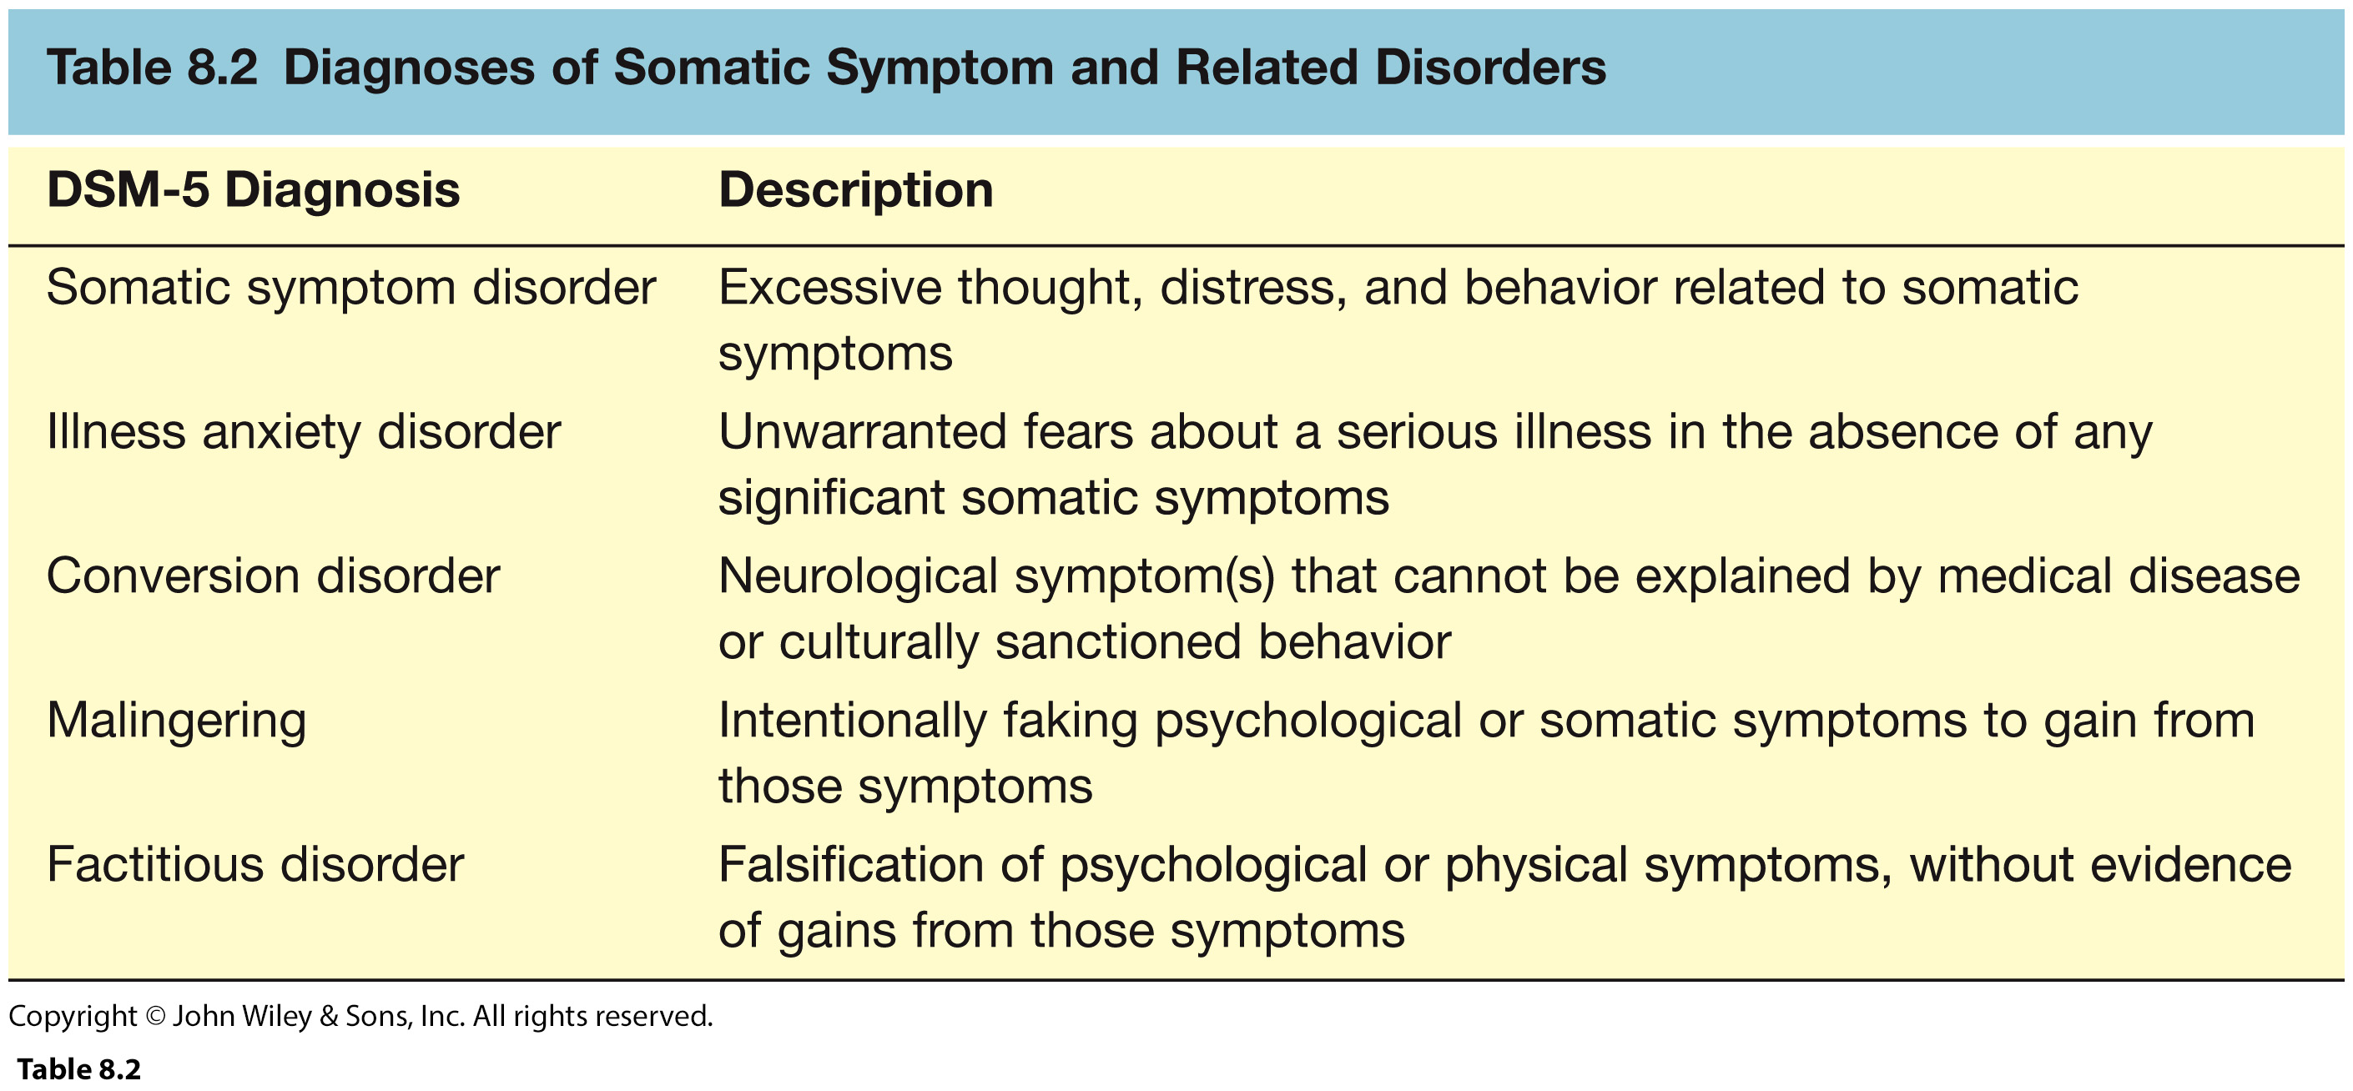
Somatic Symptom Disorders
Excessive concerns about physical symptoms or health ‘Soma’ means body

Slide 25
DSM-5 Criteria for Somatic Symptom Disorder
-At least one somatic symptom that is distressing or disrupts daily life
-Excessive thoughts, feelings, and behaviors related to somatic symptom(s) or health concerns, as indicated by at least one of the following:
health-related anxiety
disproportionate concerns about the medical seriousness of symptoms
excessive time and energy devoted to health concerns
-Duration of at least 6 months
-Specify: predominant
>>

Slide 26
DSM-5 Criteria for Illness Anxiety Disorder
Preoccupation with and high level of anxiety about having or acquiring a serious disease
Excessive behaviors (e.g., checking for signs of illness, seeking reassurance) or maladaptive avoidance (e.g., avoiding medical care)
No more than mild somatic symptoms are present
Not explained by other psychological disorders
Preoccupation lasts at least 6 months >>

Slide 27
Conversion Disorder (Hysteria DSM IV)
Sensory or motor function impaired but no known neurological cause
Vision impairment or tunnel vision
Partial or complete paralysis of arms or legs
Seizures or coordination problems
Aphonia
Whispered speech
Anosmia
Loss of smell

Slide 28
Conversion Disorder
Hippocrates
Believed disorder only occurred in women
Attributed it to a wandering uterus
Originally known as hysteria
Greek word for uterus
Freud
Coined term conversion
Anxiety and conflict converted into physical symptoms

Slide 29
DSM-5 Criteria for Conversion Disorder
One or more symptoms affecting voluntary motor or sensory function
The symptoms are incompatible with recognized medical disorders
Symptoms cause significant distress or functional impairment or warrant medical evaluation

Slide 30
Conversion Disorder
Onset typically adolescence or early adulthood
Often follows life stress
Prevalence less than 1%
More common in women than men
Often comorbid with:
Other somatic symptom disorders
Major depressive disorder
Substance use disorders >>>

Slide 31
DSM-5 Criteria: Factitious Disorder
Fabrication or induction of physical or psychological symptoms, injury, or disease
Deceptive behavior is present in the absence of obvious external rewards
Behavior is not explained by another psychological disorder

Slide 32
DSM-5 Criteria: Factitious Disorder Cont’d…
In Factitious Disorder Imposed on Self, the person presents himself or herself to others as ill, impaired, or injured
In Factitious Disorder Imposed on Another, the person fabricates or induces symptoms in another person and then presents that person to others as ill, impaired, or injured
>>

Slide 33
Etiology of Somatic Symptoms Disorders: i) Neurological Factors
There is no support for genetic influence
Concordance rates in MZ twin pairs do not differ from DZ twin pairs
Why are some people more aware and distressed by bodily sensation?
Anterior insula and anterior cingulate hyperactive
Somatic symptoms influenced by emotions and stress

Slide 34
Etiology of Somatic Symptoms Disorders: ii) Cognitive Behavioral Factors
Two important cognitive variables:
Attention to bodily sensations
Automatic focus on physical health cues
Attributions (interpretation) of those sensations
Overreact with overly negative interpretations
Two important consequences:
Sick role limits healthy life alternatives
Help-seeking behaviors reinforced by attention or sympathy

Slide 35
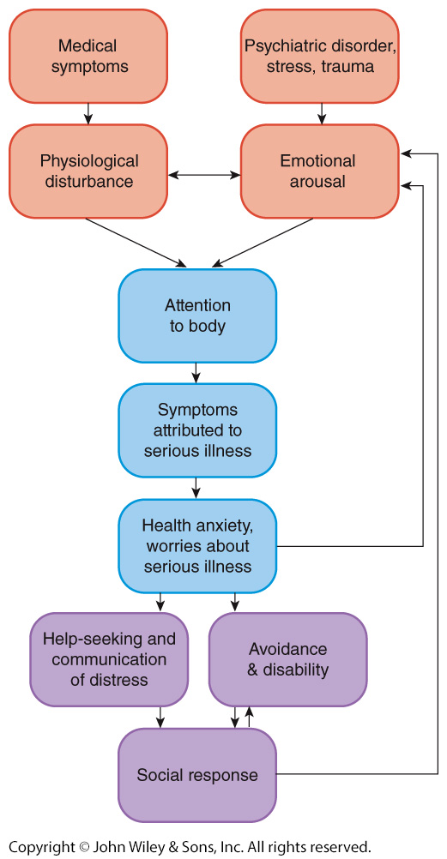
Mechanisms Involved in Somatic Symptom Disorders

Slide 36
Etiology of Conversion Disorder: i) Psychodynamic Perspective
Unconscious psychological factor cause
Blindsight
Not consciously aware of visual input
Failure to be explicitly aware of sensory information

Slide 37
Etiology of Conversion Disorder : ii) Social and Cultural Factors
Decrease in incidence of conversion disorders since last half of 19th century
Higher incidence may have been due to more repressed sexual attitudes or low tolerance for anxiety symptoms
More prevalent
In rural areas
In individuals of lower Socio Economic Status (SES)
In non-Western cultures

Slide 38
Treatment of Somatic Symptoms Disorders
Few controlled treatment outcome studies
Cognitive Behavioral Treatment
Identify and change triggering emotions
Change cognitions about symptoms
Replace sick role behaviors with more appropriate social interactions
Antidepressants
Tofranil (imipramine)
Effective even at low dosages that do not alleviate depressive symptoms >>>
>>>

Slide 39
THANK YOU

